Slide 1
QUALITY ASSURANCE

Slide 2
Quality Assurance
Quality assurance is typically focused on adherence to proper processes, in order to provide confidence that the appropriate levels of quality will be achieved.

Slide 3
Manual Testing

Slide 4
Objectives
Preventing as many defects and critical bugs as possible by careful examination.
To verify the fulfillment of all specified requirements.
To build confidence in the level of quality of the test object.
To provide sufficient information to stakeholders/business owner to allow them to make informed decisions, especially regarding the level of quality of the test object
To find defects and failures thus reduce the level of risk of inadequate software quality.

Slide 5
Errors, Defects, and Failures
Error: A mistake, misconception, or misunderstanding on the part of a software developer.
Defect: A deviation from expected software behavior caused by error
Failure: Inability of a software system or component to perform as required. Result of a defect

Slide 6
Test Types
A test type is a group of test activities aimed at testing specific characteristics of a software system, or a part of a system, based on specific test objectives

Slide 7
White-box Testing
White-box testing derives tests based on the system’s internal structure or implementation
Internal structure may include code, architecture, work flows, and/or data flows within the system
White-box test design and execution may involve knowledge, such as the way the code is built, how data is stored
Some types of white-box tests
Unit Testing
Testing for Memory Leaks
Penetration Testing
Path testing

Slide 8
Black-box Testing
In Black-box testing, a tester doesn’t have any information about the internal working of the software system
Black box testing is a high level of testing that focuses on the behavior of the software
Black box testing can be applied to virtually every level of software testing: unit, integration, system, and acceptance.
Some types of black-box tests
Functional Testing
Non-functional testing
Regression Testing

Slide 9
Functional Testing
Functional testing of a system involves tests that evaluate functions that the system should perform.
Functional requirements may be described in work products
Functional tests should be performed at all test levels
Functional testing considers the behavior of the software
Some types of functional tests
Unit testing Component testing
Smoke testing Sanity testing
Regression testing Integration testing
API testing UI testing

Slide 10
Non-functional Testing
Non-functional testing of a system evaluates characteristics of systems and software such as usability, performance efficiency or security
Non-functional testing is the testing of “how well” the system behaves
Non-functional testing can and often should be performed at all test levels, and done as early as possible
Black-box techniques may be used to derive test conditions and test cases for non-functional testing
Some types of non-functional tests
Performance Tests Load Tests
Stress Tests Volume Tests
Security Tests Upgrade & Installation Tests
Recovery Tests

Slide 11
Change-related Testing
It is designed to verify that a change to the system has been fixed correctly and does not have any adverse effects on the system as a consequence
After a defect is fixed, the software need to be tested with all test cases that failed due to the defect
It is possible that a change made in one part of the code, whether a fix or another type of change, may accidentally affect the behavior of other parts of the code
Some types of change-related testing
Functional Testing
Smoke Testing
Regression Testing
Build Verification Test
Sanity Testing

Slide 12
Test Plan
A test plan is a document detailing the objectives, resources, and processes for a specific test for a software or hardware product.
The plan typically contains a detailed understanding of the eventual workflow.
A document describing the scope, approach, resources, and schedule of intended test activities.

Slide 13
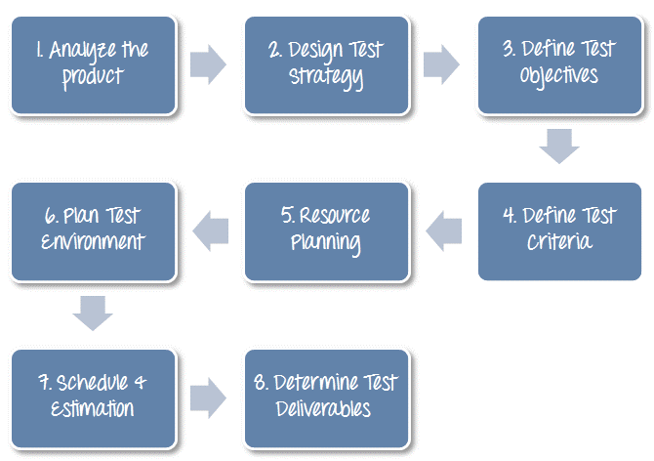
What should be included in a test plan?

Slide 14
Test Data
Input given to a software program during test execution.
It represents data that affects or affected by software execution while testing.
Test data is used for both positive testing to verify that functions produce expected results for given inputs and for negative testing to test software ability to handle unusual, exceptional or unexpected inputs.

Slide 15
Test Case
A Test Case is a set of actions executed to verify a particular feature or functionality of your software application.
A Test Case contains test steps, test data, precondition, postcondition developed for specific test scenario to verify any requirement.

Slide 16
Requirements Traceability Matrix (RTM)
Requirement Traceability Matrix (RTM) is a document that maps and traces user requirement with test cases.
It captures all requirements proposed by the client and requirement traceability in a single document, delivered at the conclusion of the Software development life cycle.
It validates that all requirements are checked via test cases such that no functionality is unchecked during Software testing.

Slide 17
Test Management
The method consists of organizing, controlling, ensuring traceability and visibility of the testing process in order to deliver the high quality software application.
Test Management is not just a single activity. It consists of a series of activities.

Slide 18
Test Organization
Test Organization in Software Testing is a procedure of defining roles in the testing process.
It defines who is responsible for which activities in testing process.
Test functions, facilities and activities are also explained in the same process.
The competencies and knowledge of the people involved are also defined however everyone is responsible for quality of testing process.

Slide 19
Test Estimation(Planning)
Test Estimation is a management activity which approximates how long a Task would take to complete.
Basically determination of how long and how much the testing cost

Slide 20
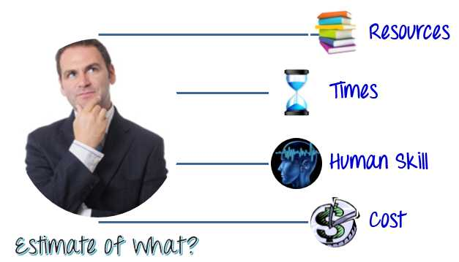

Slide 21
Test Monitoring and Control
Test Monitoring is a process in which the testing activities and testing efforts are evaluated in order to track current progress of testing activity, finding and tracking test metrics, estimating the future actions based on the test metrics and providing feedback to the concerned team as well as stakeholders about current testing process.
Test Control in test execution is a process of taking actions based on results of the test monitoring process.

Slide 22
How to monitor and control test?
Create monitoring plan
Update progress record
Analyze record and make adjustments
Procedure the report

Slide 23
Risks Analysis
Risk is the probability of occurrence of an undesirable event.
Risk should be identified and corresponding solutions should be determined before the start of the project.

Slide 24
How to perform risk analysis?
Identify the Risks
Analyze Impact of each Identified Risk
Take countermeasures for the identified & Analyzed risk

Slide 25
Defect Management
Defect Management is a systematic process to identify and fix bugs.

Slide 26
Defect Management Process
Discovery of Defect
Defect Categorization
Fixing of Defect by developers
Verification by Testers
Defect Closure
Defect Reports

